Slide 1

Advanced
Game Theory
From
Mathematical Optimization and Economic Theory
Jacob Wyngaard

Slide 2
Vertex Enumeration Fundamentals
How do we know that a player’s best response is on a vertex?
A vertex on a polytope is a point which cannot be written as a convex combination of other points in the polytope
Suppose that Player 1’s best response $p^{1∗}$ is not a vertex
Note that the best response $p^{1∗}=\underset{p^{1}∈ℝ^{m}}{arg max}{p^{1}A(p^{2})^{T}}$
Carathéodory's theorem
Any point within a convex hull in $ℝ^{n}$ can be written as the convex combination of at most $n+1$ vectices
${⇒p}^{1∗}=\sum_{i}{w_{i}v_{i}}$ with $\sum_{i}{w_{i}}=1$ where $v_{i}≠p^{1∗} ∀i$

Slide 3
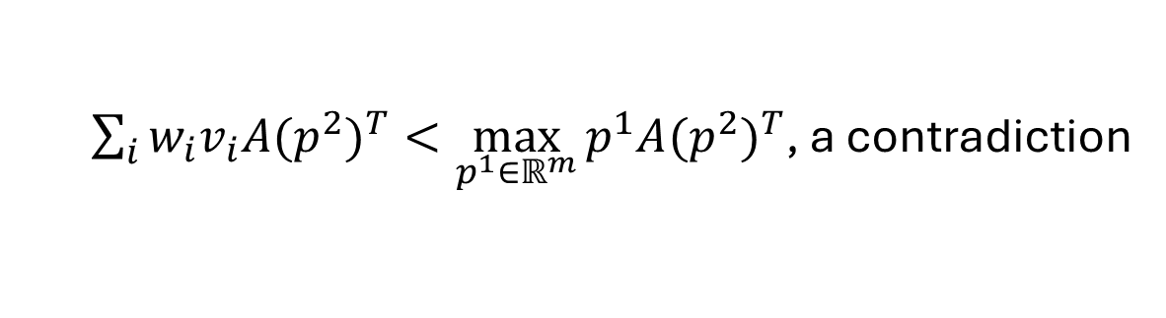
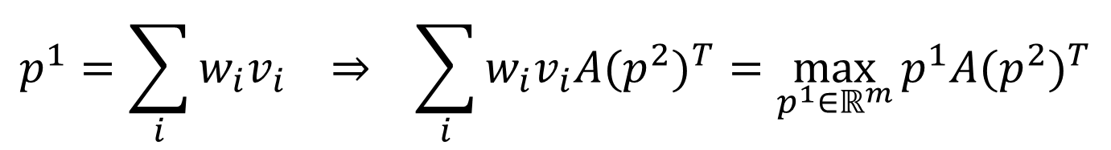
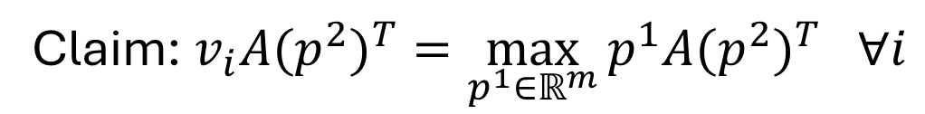
Vertex Enumeration Fundamentals
$$p^{1}=\sum_{i}{w_{i}v_{i}} ⇒ \sum_{i}{{w_{i}v}_{i}A(p^{2})^{T}}=\max_{p^{1}∈ℝ^{m}}{p^{1}A(p^{2})^{T}}$$
Claim: $v_{i}A(p^{2})^{T}=\max_{p^{1}∈ℝ^{m}}{p^{1}A(p^{2})^{T} ∀i}$
Proof by Contradiction: Suppose $v_{i}A(p^{2})^{T}<\max_{p^{1}∈ℝ^{m}}{p^{1}A(p^{2})^{T} }$for $i=k$
$$\sum_{i≠k}{{w_{i}v}_{i}A(p^{2})^{T}}≤\sum_{i≠k}{w_{i}\max_{p^{1}∈ℝ^{m}}{p^{1}A(p^{2})^{T} }}$$
$${w_{k}v}_{k}A(p^{2})^{T}+\sum_{i≠k}{{w_{i}v}_{i}A(p^{2})^{T}}<\sum_{i≠k}{w_{i}}\max_{p^{1}∈ℝ^{m}}{p^{1}A(p^{2})^{T}}+w_{k}\max_{p^{1}∈ℝ^{m}}{p^{1}A(p^{2})^{T} }$$
$\sum_{i}{{w_{i}v}_{i}A(p^{2})^{T}}<\max_{p^{1}∈ℝ^{m}}{p^{1}A(p^{2})^{T}}$, a contradiction

Slide 4
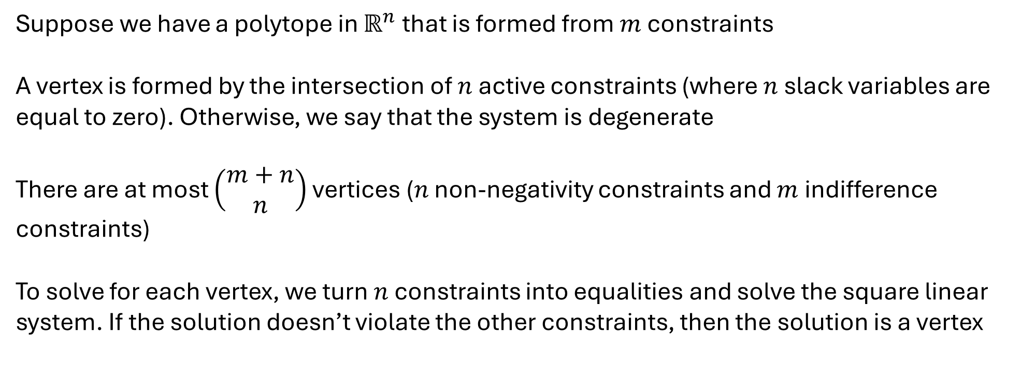
Combinatorial Vertex Enumeration
Suppose we have a polytope in $ℝ^{n}$ that is formed from $m$ constraints
A vertex is formed by the intersection of $n$ active constraints (where $n$ slack variables are equal to zero). Otherwise, we say that the system is degenerate
There are at most $\left(\begin{matrix}m+n \\ n\end{matrix}\right)$ vertices ($n$ non-negativity constraints and $m$ indifference constraints)
To solve for each vertex, we turn $n$ constraints into equalities and solve the square linear system. If the solution doesn’t violate the other constraints, then the solution is a vertex

Slide 5
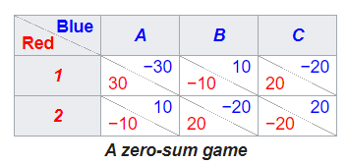


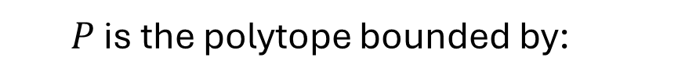

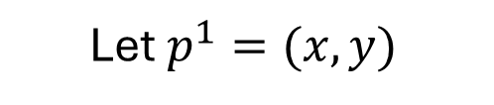


Combinatorial Vertex Enumeration
Let’s go back to this example:
$$P=\left\{p^{1}∈ℝ^{m} \right| {(Π^{2})}^{T}p^{1}≤1, p^{1}≥0\}$$
20
Let $p^{1}=(x,y)$
30
3
6
-10
-2
-20
$P$ is the polytope bounded by:
-10
-4
20
5
4
$$6x−4y ≤1$$
$$−2x+5y≤1$$
$$3x+4y ≤1$$
$$x ≥0$$
$$y ≥0$$

Slide 6
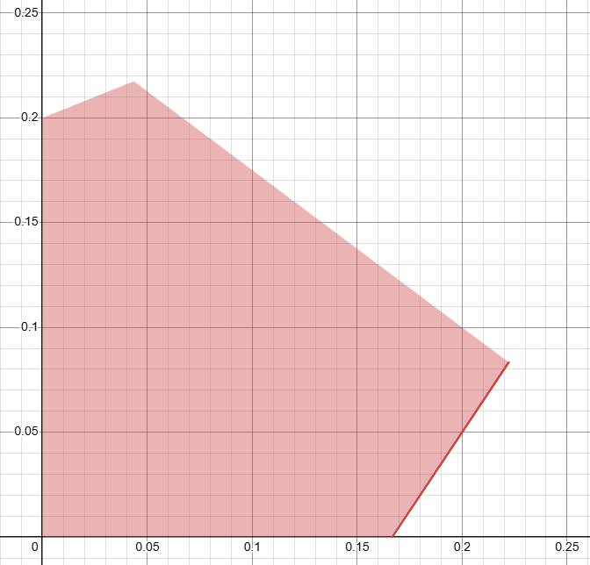


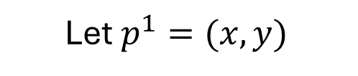
Combinatorial Vertex Enumeration
Consider the following example:
$$P=\left\{p^{1}∈ℝ^{m} \right| {(Π^{2})}^{T}p^{1}≤1, p^{1}≥0\}$$
20
Let $p^{1}=(x,y)$
30
3
6
-10
-2
$$y$$
-10
-20
-4
20
5
4
$$x$$

Slide 7





















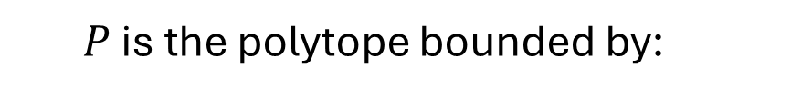




Combinatorial Vertex Enumeration
Since our probability vector $p^{1}$ lives in $ℝ^{n}$, we select two constraints at a time to make strict and solve
$$6x−4y=1$$
$$−2x+5y=1$$
$P$ is the polytope bounded by:
$$−2x+5y=1$$
$$x=0$$
$$6x−4y=1$$
$$−2x+5y=1$$
$$6x−4y ≤1$$
$$3x+4y=1$$
$$y=0$$
$$−2x+5y≤1$$
$$6x−4y=1$$
$$3x+4y=1$$
$$3x+4y ≤1$$
$$x=0$$
$$x=0$$
$$x ≥0$$
$$6x−4y=1$$
$$3x+4y=1$$
$$y ≥0$$
$$y=0$$
$$y=0$$
$$−2x+5y=1$$
$$x=0$$
$$3x+4y=1$$
$$y=0$$

Slide 8















Combinatorial Vertex Enumeration
Since our probability vector $p^{1}$ lives in $ℝ^{n}$, we select two constraints at a time to make strict and solve
$$x=9/22$$
$$x=0$$
$$y=4/11$$
$$y=1/5$$
$P$ is the polytope bounded by:
$$x=2/9$$
$$x=−1/2$$
$$6x−4y ≤1$$
$$y=1/12$$
$$y=0$$
$$−2x+5y≤1$$
$$x=0$$
$$x=0$$
$$3x+4y ≤1$$
$$y=−1/4$$
$$y=1/4$$
$$x ≥0$$
$$x=1/6$$
$$x=1/3$$
$$y ≥0$$
$$y=0$$
$$y=0$$
$$x=1/23$$
$$x=0$$
$$y=5/23$$
$$y=0$$

Slide 9
Combinatorial Vertex Enumeration
Since our probability vector $p^{1}$ lives in $ℝ^{n}$, we select two constraints at a time to make strict and solve
$$x=9/22$$
$$x=0$$
$$y=4/11$$
$$y=1/5$$
$P$ is the polytope bounded by:
$$x=2/9$$
$$x=−1/2$$
$$6x−4y ≤1$$
$$y=1/12$$
$$y=0$$
$$−2x+5y≤1$$
$$x=0$$
$$x=0$$
$$3x+4y ≤1$$
$$y=−1/4$$
$$y=1/4$$
$$x ≥0$$
$$x=1/6$$
$$x=1/3$$
$$y ≥0$$
$$y=0$$
$$y=0$$
Eliminate Vertices That Violate Constraints
$$x=1/23$$
$$x=0$$
$$y=5/23$$
$$y=0$$

Slide 10












Combinatorial Vertex Enumeration
$$y$$
$$x=0$$
$$y=1/5$$
$$x=2/9$$
$$y=1/12$$
$$x=1/6$$
$$y=0$$
$$x=1/23$$
$$y=5/23$$
$$x=0$$
$$y=0$$
$$x$$

Slide 11
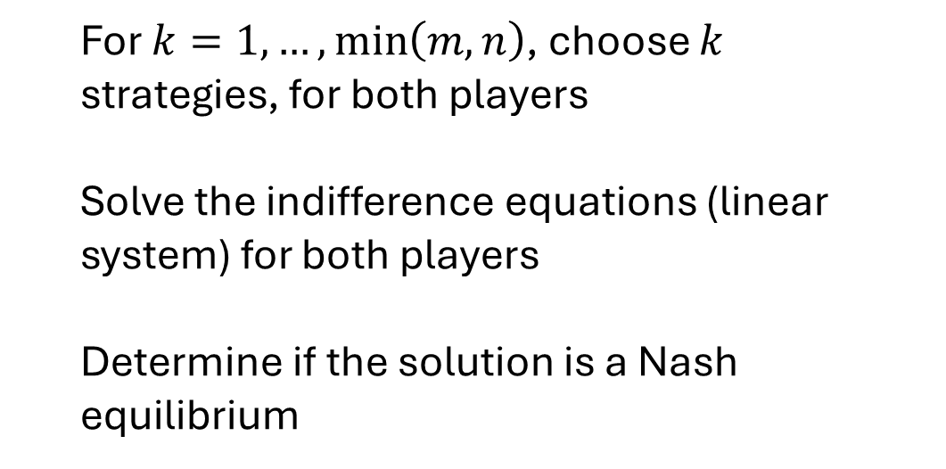
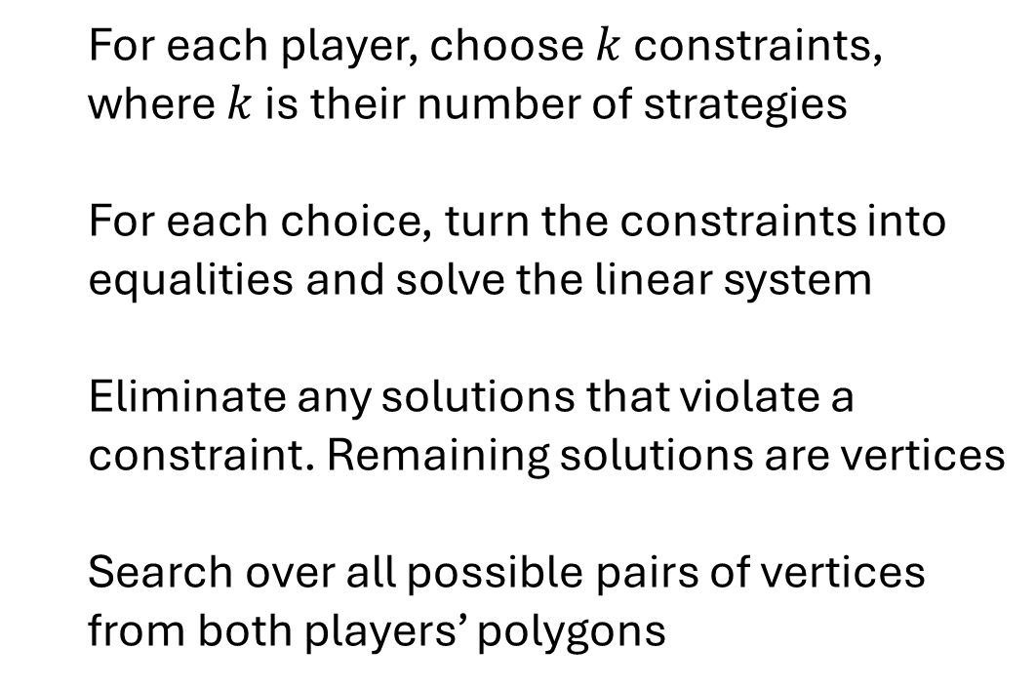
Combinatorial Vertex Enumeration
What makes this different from Support Enumeration?
Support Enumeration
Combinatorial Vertex Enumeration
For $k=1,…,\min\left(m,n\right)$, choose $k$ strategies, for both players
Solve the indifference equations (linear system) for both players
Determine if the solution is a Nash equilibrium
For each player, choose $k$ constraints, where $k$ is their number of strategies
For each choice, turn the constraints into equalities and solve the linear system
Eliminate any solutions that violate a constraint. Remaining solutions are vertices
Search over all possible pairs of vertices from both players’ polygons

Slide 12
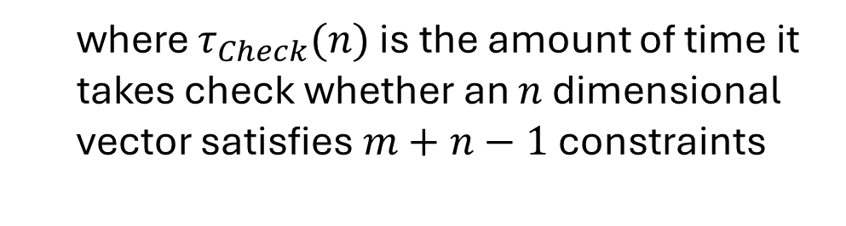

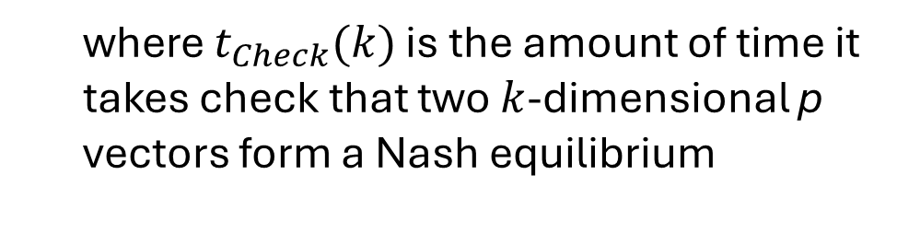
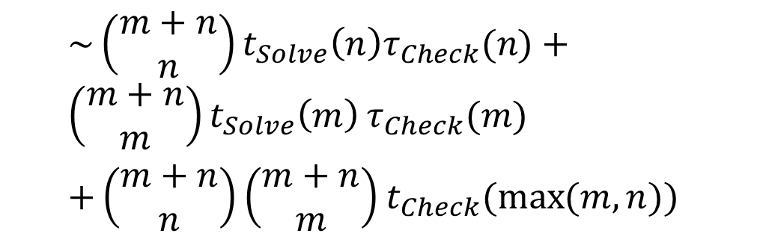
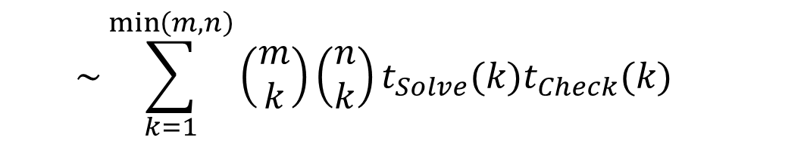
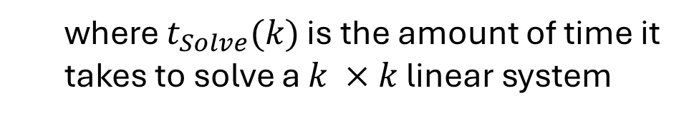
Combinatorial Vertex Enumeration
Computational Runtime
Support Enumeration
Combinatorial Vertex Enumeration
$$\sim \sum_{k=1}^{\min\left(m,n\right)}{\left(\begin{matrix}m \\ k\end{matrix}\right)\left(\begin{matrix}n \\ k\end{matrix}\right)}t_{Solve}(k)t_{Check}(k)$$
$\sim \left(\begin{matrix}m+n \\ n\end{matrix}\right)t_{Solve}\left(n\right)τ_{Check}(n)+\left(\begin{matrix}m+n \\ m\end{matrix}\right)t_{Solve}\left(m\right)$ $τ_{Check}(m)$
$+\left(\begin{matrix}m+n \\ n\end{matrix}\right)\left(\begin{matrix}m+n \\ m\end{matrix}\right)$ $t_{Check}(\max{(m,n)})$
where $t_{Solve}(k)$ is the amount of time it takes to solve a $k ×k$ linear system
where $t_{Check}(k)$ is the amount of time it takes check that two $k$-dimensional p vectors form a Nash equilibrium
where $τ_{Check}(n)$is the amount of time it takes check whether an $n$ dimensional vector satisfies $m+n−1$ constraints

Slide 13



Combinatorial Vertex Enumeration
Computational Runtime (if $m=n)$
Support Enumeration
Combinatorial Vertex Enumeration
Worst Case
$$\sim \sum_{k=1}^{n}{{\left(\begin{matrix}n \\ k\end{matrix}\right)}^{2}}t_{Solve}(n)t_{Check}(n)$$
$$\sim \left(\begin{matrix}2n \\ n\end{matrix}\right)t_{Solve}\left(n\right)τ_{Check}\left(n\right)$$
$+{\left(\begin{matrix}2n \\ n\end{matrix}\right)}^{2}$ $t_{Check}(n)$
Using the central binomial coefficient:
$$\sim \left(\begin{matrix}2n \\ n\end{matrix}\right)t_{Solve}(n)t_{Check}(n)$$
This is a lot slower! I need to implement in Python to confirm

Slide 14
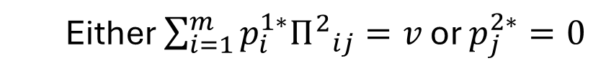
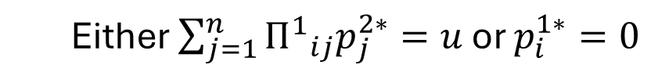
Vertex Enumeration Review
For non-degenerate, finite two player games, vertex enumeration obtains best response polytopes for both players and iterates through all possible pairs of vertices to obtain the Nash equilibrium
A pair of vertices correspond to a Nash equilibrium if they are fully labeled
Complementary Conditions for Fully Labeled Vertices
What’s the intuition here??
For all Player 1 strategies $i$ and Player 2 strategies $j$:
$\sum_{j=1}^{n}{{Π^{1}}_{ij}p_{j}^{2∗}≤u},\sum_{i=1}^{m}{p_{i}^{1∗}{Π^{2}}_{ij}≤v},p^{1∗}$and $p^{2∗}$ probability vectors
Either $\sum_{j=1}^{n}{{Π^{1}}_{ij}p_{j}^{2∗}=u}$ or $p_{i}^{1∗}=0$
Either $\sum_{i=1}^{m}{p_{i}^{1∗}{Π^{2}}_{ij}=v}$ or $p_{j}^{2∗}=0$
where $u,v$ correspond respectively to the equilibrium expected payoffs for Players 1 and 2
and $Π^{1},Π^{2}$correspond respectively to payoff matrices for Players 1 and 2

Slide 15
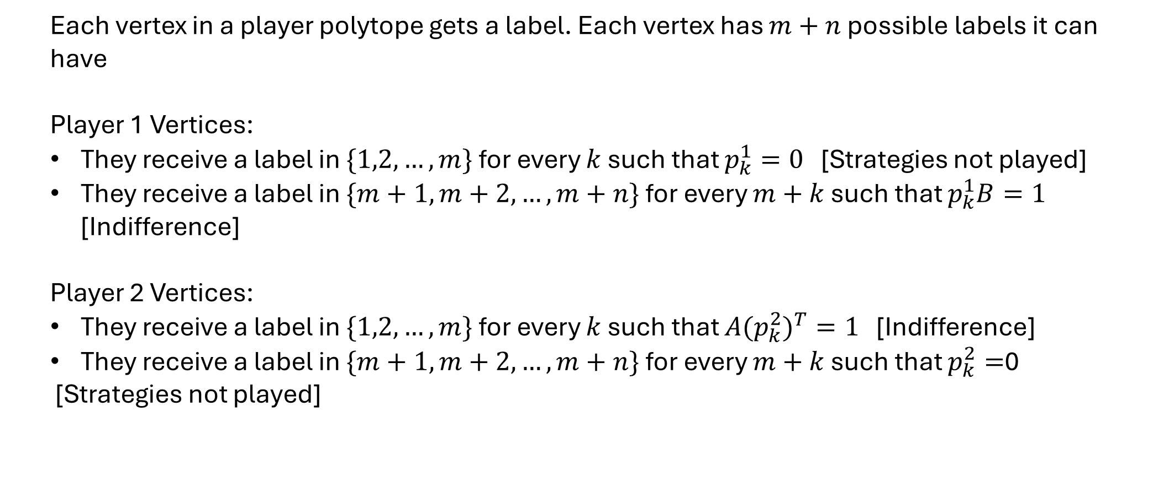
Fully Labeled Pairs of Vertices
Each vertex in a player polytope gets a label. Each vertex has $m+n$ possible labels it can have
Player 1 Vertices:
They receive a label in $\{1,2,…,m\}$for every $k$ such that $p_{k}^{1}=0$ [Strategies not played]
They receive a label in $\{m+1,m+2,…,m+n\}$for every $m+k$ such that $p_{k}^{1}B=1$ [Indifference]
Player 2 Vertices:
They receive a label in $\{1,2,…,m\}$for every $k$ such that ${A(p_{k}^{2})}^{T}=1$ [Indifference]
They receive a label in $\{m+1,m+2,…,m+n\}$for every $m+k$ such that $p_{k}^{2}=$0
[Strategies not played]

Slide 16
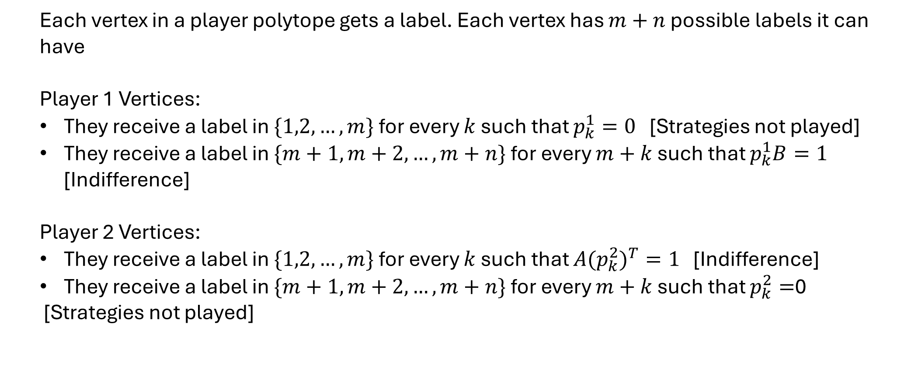
Fully Labeled Pairs of Vertices
Each vertex in a player polytope gets a label. Each vertex has $m+n$ possible labels it can have
Player 1 Vertices:
They receive a label in $\{1,2,…,m\}$for every $k$ such that $p_{k}^{1}=0$ [Strategies not played]
They receive a label in $\{m+1,m+2,…,m+n\}$for every $m+k$ such that $p_{k}^{1}B=1$ [Indifference]
Player 2 Vertices:
They receive a label in $\{1,2,…,m\}$for every $k$ such that ${A(p_{k}^{2})}^{T}=1$ [Indifference]
They receive a label in $\{m+1,m+2,…,m+n\}$for every $m+k$ such that $p_{k}^{2}=$0
[Strategies not played]
Each label (strategy) can come from Player 1’s polytope or Player 2’s polytope

Slide 17
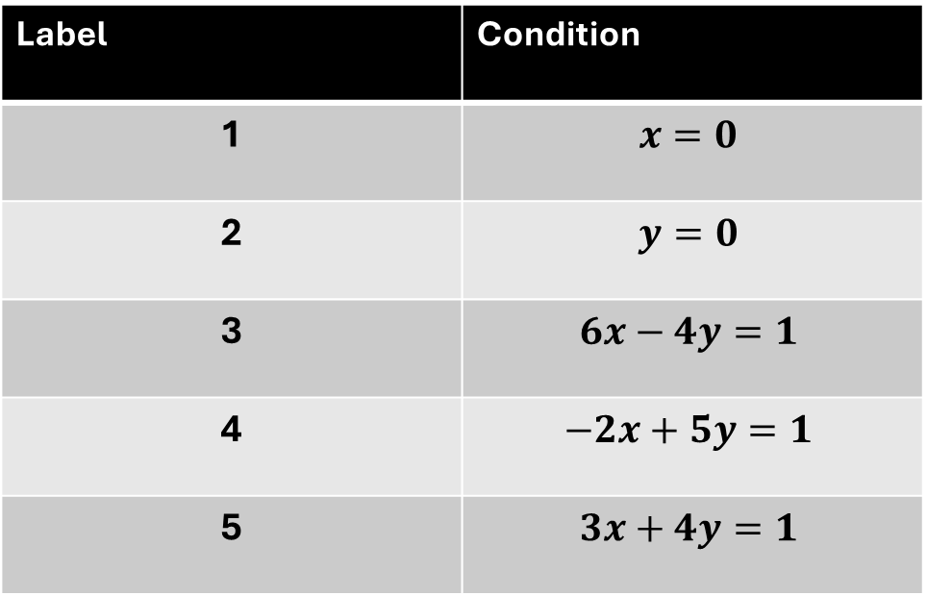
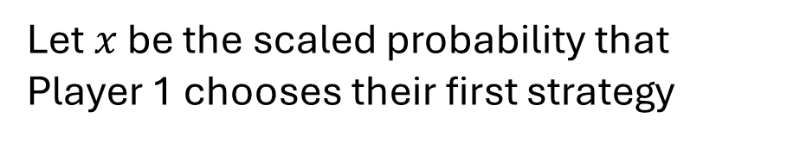
Vertex Labeling Example
$$y$$
Let $x$ be the scaled probability that Player 1 chooses their first strategy
4,5
Label | Condition
1 | $$x=0$$
2 | $$y=0$$
3 | $$6x−4y=1$$
4 | $$−2x+5y=1$$
5 | $$3x+4y=1$$
1,4
3,5
1,2
2,3
$$x$$

Slide 18

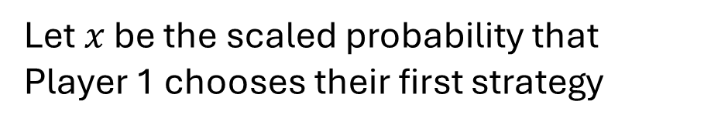


Vertex Labeling Example
$$y$$
Let $x$ be the scaled probability that Player 1 chooses their first strategy
4,5
Label | Condition
1 | $$x=0$$
2 | $$y=0$$
3 | $$6x−4y=1$$
4 | $$−2x+5y=1$$
5 | $$3x+4y=1$$
1,4
Can we use labeling to prune the vertex pairs we have to check for Nash equilibrium?
3,5
1,2
2,3
$$x$$

Slide 19
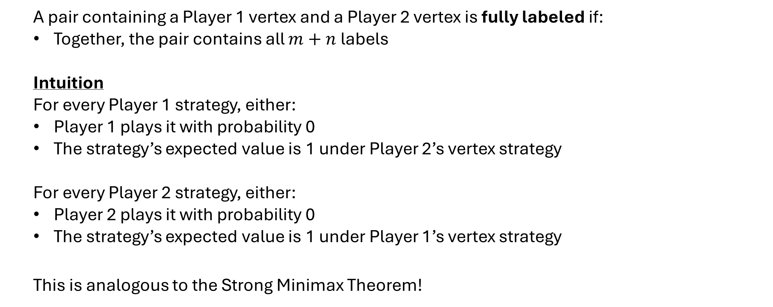
Fully Labeled Pairs of Vertices
A pair containing a Player 1 vertex and a Player 2 vertex is fully labeled if:
Together, the pair contains all $m+n$ labels
Intuition
For every Player 1 strategy, either:
Player 1 plays it with probability 0
The strategy’s expected value is 1 under Player 2’s vertex strategy
For every Player 2 strategy, either:
Player 2 plays it with probability 0
The strategy’s expected value is 1 under Player 1’s vertex strategy
This is analogous to the Strong Minimax Theorem!

Slide 20
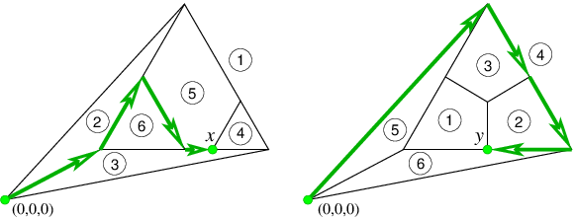
Simplex Algorithm and Nash Equilibrium
Is there a way to use the mechanics of the simplex algorithm to find Nash equilibrium?
This is the intuition behind the Lemke-Howson Algorithm

Slide 21
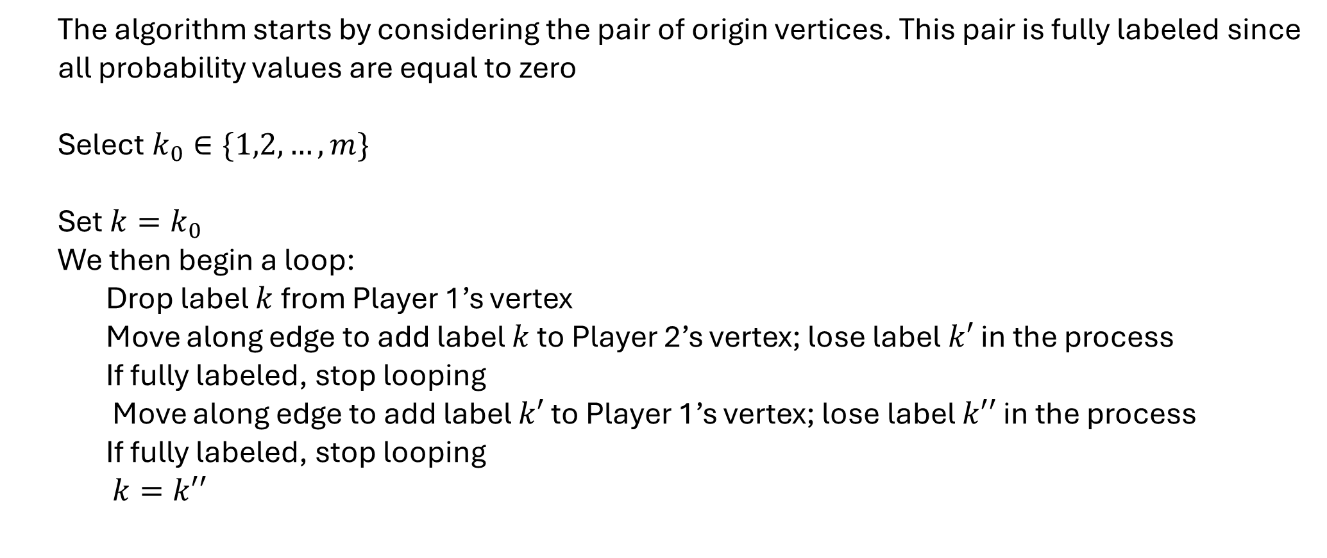
Lemke-Howson Algorithm
The algorithm starts by considering the pair of origin vertices. This pair is fully labeled since all probability values are equal to zero
Select $k_{0}∈\{1,2,…,m\}$
Set ${k=k}_{0}$
We then begin a loop:
Drop label $k$ from Player 1’s vertex
Move along edge to add label $k$ to Player 2’s vertex; lose label $k′$ in the process
If fully labeled, stop looping
Move along edge to add label $k′$ to Player 1’s vertex; lose label $k′′$ in the process
If fully labeled, stop looping
$k=k′′$

Slide 22



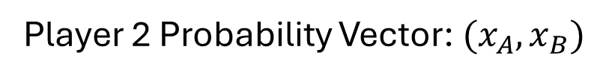

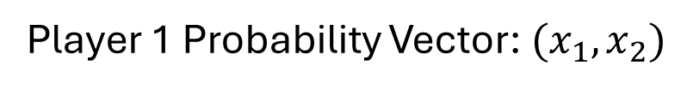




Lemke-Howson Algorithm
Example:
Player 1 Payoffs
Player 2 Payoffs
A
B
A
B
4 | 1
2 | 3
1 | 4
3 | 2
1
1
2
2
Player 1 Probability Vector: $(x_{1},x_{2})$
Player 2 Probability Vector: $(x_{A},x_{B})$
$$4x_{1}+2x_{2}≤1$$
$$1x_{A}+4x_{B}≤1$$
$$1x_{1}+3x_{2}≤1$$
$$3x_{A}+2x_{B}≤1$$
$$x_{1}≥0$$
$$x_{A}≥0$$
$$x_{2}≥0$$
$$x_{B}≥0$$

Slide 23
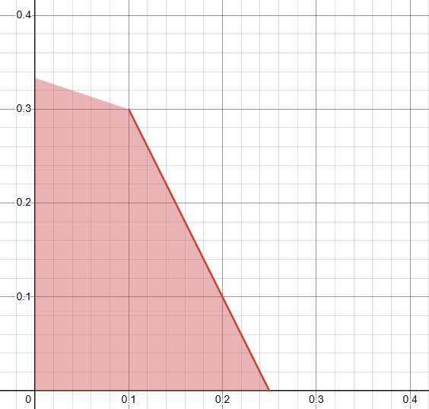
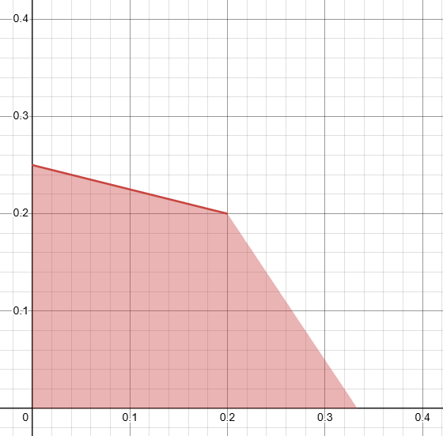




Lemke-Howson Algorithm
Example:
$$x_{2}$$
Player 1 Polytope
$$x_{B}$$
Player 2 Polytope
$$x_{1}$$
$$x_{A}$$

Slide 24
Lemke-Howson Algorithm
Example:
$$x_{2}$$
Player 1 Polytope
$$x_{B}$$
Player 2 Polytope
Start with the pair of origin vertices
1,2
A,B
$$x_{1}$$
$$x_{A}$$

Slide 25

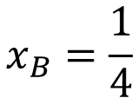
Lemke-Howson Algorithm
Example:
$$x_{2}$$
Player 1 Polytope
$$x_{B}$$
Player 2 Polytope
“Drop” Label 1 from Player 1 Polytope
Strategy 1 must have highest expected value
A,1
$$1x_{A}+4x_{B}=1$$
$$x_{B}=\frac{1}{4}$$
1,2
A,B
$$x_{1}$$
$$x_{A}$$

Slide 26

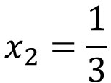
Lemke-Howson Algorithm
Example:
$$x_{2}$$
Player 1 Polytope
$$x_{B}$$
Player 2 Polytope
Strategy B must have highest expected value
1,B
A,1
$$1x_{1}+3x_{2}=1$$
$$x_{2}=\frac{1}{3}$$
1,2
$$x_{1}$$
$$x_{A}$$

Slide 27
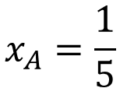
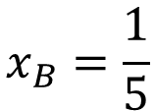

Lemke-Howson Algorithm
Example:
$$x_{2}$$
Player 1 Polytope
$$x_{B}$$
Player 2 Polytope
Strategy 2 must have highest expected value
1,B
A,1
$$3x_{A}+2x_{B}=1$$
1,2
$$x_{A}=\frac{1}{5}$$
$$x_{B}=\frac{1}{5}$$
$$x_{1}$$
$$x_{A}$$

Slide 28

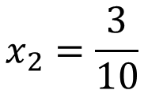
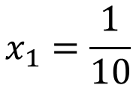
Lemke-Howson Algorithm
Example:
$$x_{2}$$
Player 1 Polytope
$$x_{B}$$
Player 2 Polytope
Strategy A must have highest expected value
1,B
A,B
$$4x_{1}+2x_{2}=1$$
$$x_{1}=\frac{1}{10}$$
1,2
$$x_{2}=\frac{3}{10}$$
$$x_{1}$$
$$x_{A}$$

Slide 29
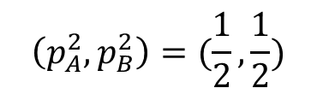
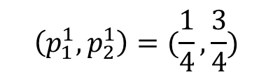
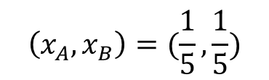
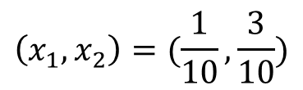
Lemke-Howson Algorithm
Example:
$$x_{2}$$
Player 1 Polytope
$$x_{B}$$
We stop because we are fully labeled
Player 2 Polytope
$$\left(x_{1},x_{2}\right)=(\frac{1}{10},\frac{3}{10})$$
A,B
$$\left(x_{A},x_{B}\right)=(\frac{1}{5},\frac{1}{5})$$
1,2
$$\left(p_{1}^{1},p_{2}^{1}\right)=(\frac{1}{4},\frac{3}{4})$$
$$\left(p_{A}^{2},p_{B}^{2}\right)=(\frac{1}{2},\frac{1}{2})$$
This is our Nash Equilibrium
$$x_{1}$$
$$x_{A}$$

Slide 30

Brown-von Neumann- Nash Dynamics
We use the set of continuous functions that Nash defined for his existence proof:
$$φ_{ij}\left(p\right)=max⁡(0, {Payoff}_{i}\left(e_{j}\right)−{Payoff}_{i}\left(p\right))$$
${Payoff}_{i}\left(e_{j}\right) −$ payoff to $i$th Player from playing pure strategy $j$
${Payoff}_{i}\left(p\right) −$ payoff to $i$th Player from playing strategy $p$
$φ_{ij}\left(p\right)−$ either $0$ or the value gained by switching to pure strategy $j$
We evolve each player’s probabilities according to the following ODE:
$${\dot{p}}_{ij}=φ_{ij}\left(p\right)−p_{ij}\sum_{k}{φ_{ik}\left(p\right)}$$
$p_{ij}\left(p\right)−$ the probability that player $i$ chooses strategy $j$

